Slide 1
Marketing Task Force
Marketing Plan

Slide 2
Meeting Overview
Address data questions from past meeting
Survey
Demographics
Marketing Budget
Review task force progress objectives
Start conversation of marketing message
View other Community College’s marketing efforts

Slide 3
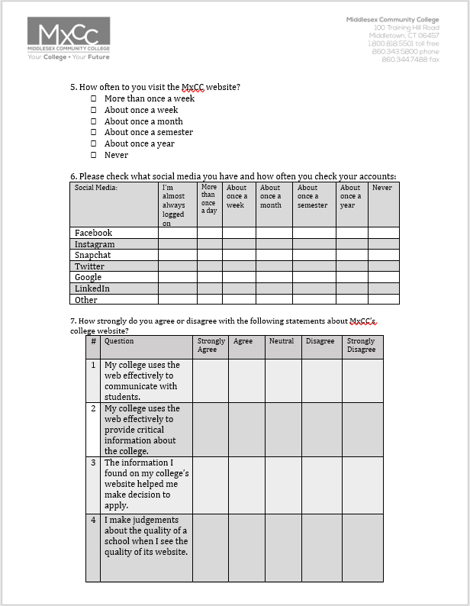
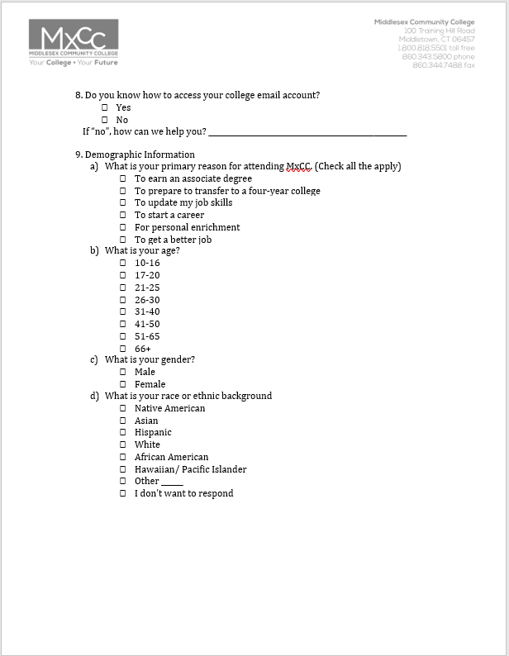
Survey
Thoughts and Feed back

Slide 4
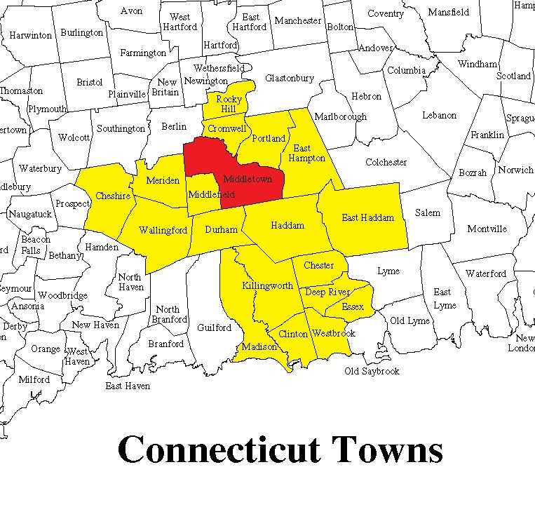
Demographics Of MxCC
2017 Fast Facts- by Head Count and Towns
MxCC serves more than 4,000+ credit students and 1,600 non-credit students a year.
Fall 2016: 2,740 students (credit-only); 1,562 (full-time equivalent).
Fall 2015: 2,910 students (credit only); 1,726 (full-time equivalent).
Major towns/cities served by MxCC: Chester, Clinton, Cromwell, Deep River, Durham, East Haddam, East Hampton, Essex, Haddam, Killingworth, Meriden, Middlefield, Middletown, Old Saybrook, Portland, Rocky Hill, Wallingford, and Westbrook, plus approximately 100 other Connecticut towns.
Fall 2017 45.0% of credit students reside in Middletown, Meriden & Wallingford

Slide 5
Demographics Of MxCC
2017 Fast Facts
Average age: 26.6 years
58.2% Women
35.7% Full Time
Minorities: 36.7%
Employed: 70%
Receive Financial Aid: 56%
309 students attending Platt High School (MxCC@Platt) and 40 students attending Wilcox Tech High School (Manufacturing Machine Technology Program).

Slide 6
Demographics Of MxCC
Student Profile
 | Fall 2016 | Fall 2017
Total MxCC Population | 2740 | 2688
Average Age | 12 – 84 years | 14 years - 85 years
Age Range | 26.6 years | 26.1 years
New Students | 20.8% | 22%
Full-Time Students | 35.7% | 37%

Slide 7
Marketing Budget

Slide 8
Marketing Budget
*60 % of total budget used as of 10/19/17

Slide 9
Task Force Objectives
What is our message going to be? (Todays Job)
How do we want it to look?
Branding Style
Tracking
Where & How to communicate the message?

Slide 10
Marketing Message
What should our message be?
What should it say about us?
Your College •Your Future

